Slide 1
BLISS- Blended Learning Implementation for reSilient, acceSsible and efficient higher education
Funded by the European Union. Views and opinions expressed are however those of the author(s) only and do not necessarily reflect those of the European Union or the European Education and Culture Executive Agency (EACEA). Neither the European Union nor EACEA can be held responsible for them.
UNIRI – EdUnit 1 (Statistical data analysis in HCI research)
Disclaimer: Funded by the European Union. Views and opinions expressed are however those of the author(s) only and do not necessarily reflect those of the European Union or the European Education and Culture Executive Agency (EACEA). Neither the European Union nor EACEA can be held responsible for them.

Slide 2
EdUnit Overview
Mother Course: Human-Computer Interaction (elective, 6 ECTS)
Mother Programme: Graduate University Study of Computing

Slide 3
Unit Overview
The empirical approach to Human-Computer Interaction (HCI) focuses on an experiment in which the users, i.e. participants, perform a task or a series of tasks and thus investigate the properties of an interactive system. The research questions investigated in HCI experiment are usually comparative. Typically, the goal is to compare two or more interfaces or interaction techniques to determine which of them performs better in terms of one or more dependent variables, such as task completion time, error rate, number of retries, and so on. In this context, it is crucial to analyze the data collected through the experiment in an appropriate, formally correct way.
This educational unit describes and introduces some useful statistical tools and techniques typically used in empirical HCI research. In particular, it analyzes the use of statistical procedures for hypothesis testing, which come in two varieties: parametric tests and non-parametric tests. The specific aim of the educational unit is to explain and demonstrate, using relevant examples, how to detect the right statistical test (with respect to the design of the HCI experiment), apply the chosen statistical test, interpret / report the results correctly, and derive appropriate conclusions / generalizations.

Slide 4
EdUnit Overview
Course Topic: Statistical data analysis in HCI research
Blended Learning (F2F driver): In-class presentation, mock-up cases, online learning / training and case solving, in-class presentation and discussion

Slide 5
Constructive Alignment: ILO
Select and apply appropriate statistical tests on data obtained from a HCI experiment, and derive the conclusions according to their outcomes.
Verb(s): REMEMBER [select], APPLY [apply, derive] [ https://tips.uark.edu/blooms-taxonomy-verb-chart/ ]
Content: Statistical test
Context: HCI experiment

Slide 6
Constructive Alignment: TLAs
Week 1
ILO reference | Teaching Activity (What the teachers do) | Learning Activity (What the students do)
Select and apply appropriate statistical tests on data obtained from a HCI experiment, and derive the conclusions according to their outcomes | TA 1 / In-class Contextualization of the importance of statistics in empirical HCI research. Presenting standard statistical tests typically used on data obtained from a HCI experiment. TA 2 / In-class Explain how the appropriate test should be chosen, according to the design of the HCI experiment. Directing attention to the diagram for the selection of statistical tests. Encouraging questioning and discussion. TA 3 / In-class Demonstrate an example of applying a statistical test, and how results and conclusions should be reported. Different software can be utilized. Encouraging questioning and discussion. TA 4 / In-class & Online Present (prepare and deliver via LMS) a small-scale case study: a hypothetical HCI experiment (description) and corresponding data (online data generators can be utilized). Provide web links to online tutorials and supplementary learning material. Recommend possible software tools. Provide a rubric (checklist). Support students online (via LMS forum). | LA 1 / In-class Listen to the presentation, take notes and ask questions. LA 2 / In-class Listen to the presentation, take notes and ask questions. LA 3 / In-class Listen to the presentation, observe the demonstration, take notes and ask questions. LA 4 / Online Analyze the description and data from the obtained mock-up case. Select the appropriate statistical test for a given case study. Utilize the online resources (tutorials, wide web search), and get familiar with the software selected for statistical analysis. Apply statistical analysis (within software tool), derive conclusions, write and submit report via LMS. If necessary, ask for help / clarifications on the LMS forum. Prepare a presentation.

Slide 7
Constructive Alignment: TLAs
Week 1
Supporting Materials:
presentation / slides
Mock-up cases descriptions and data (MS Excel files), supplementary learning materials (pdf documents, web links), a rubric (pdf file).
Supporting equipment:
PC / laptop, in-class projector, statistical software (Excel, SPSS, Python environment and libraries), LMS
Supporting facilities: Lecture room

Slide 8
Materials
Week 1

Slide 9
Constructive Alignment: TLAs
Week 2
ILO reference | Teaching Activity (What the teachers do) | Learning Activity (What the students do)
Select and apply appropriate statistical tests on data obtained from a HCI experiment, and derive the conclusions according to their outcomes | TA 5 / In-class & Online Organize student presentations. Ask questions and encourage a collaborative discussion on the case study following each presentation. Evaluate the presentations / reports according to the rubric previously given. Provide feedback for each mock-up case (student/group) via LMS. | LA 5 / In-class Present the results of the mock-up case analysis. Answer the teacher's questions and actively participate in the joint discussion of other cases.

Slide 10
Constructive Alignment: TLAs
Week 2
Supporting Materials:
Mock-up cases descriptions, a rubric (pdf file), a rubric (pdf file), teacher solutions, student presentation (ppt / pdf file)
Supporting equipment:
PC / laptop, in-class projector, statistical software (Excel, SPSS, Python environment and libraries), LMS
Supporting facilities: Lecture room

Slide 11
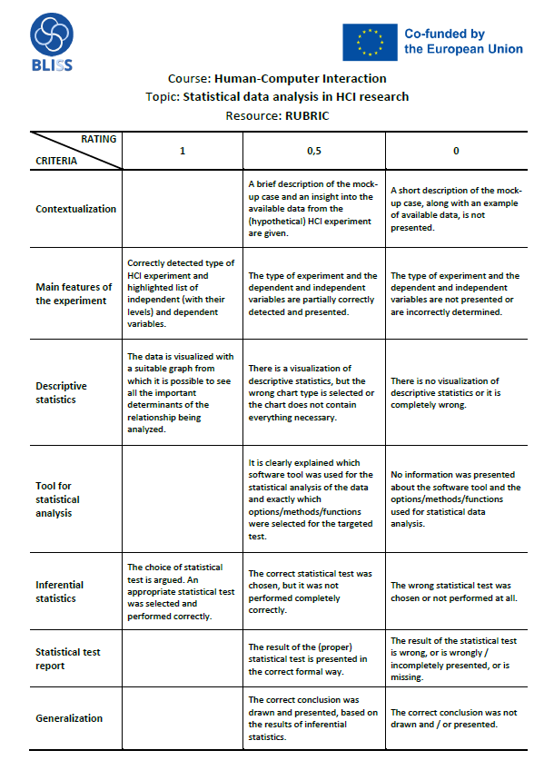
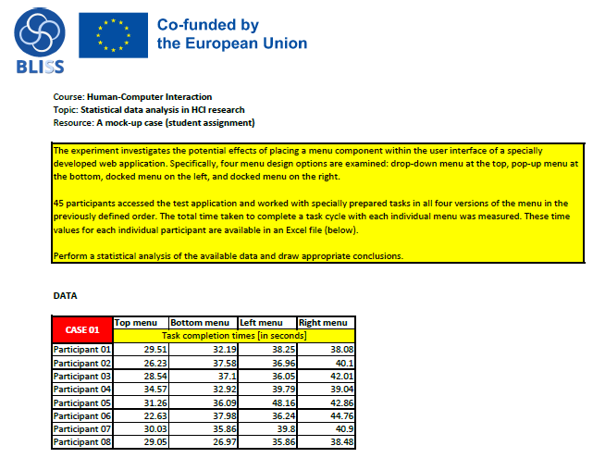
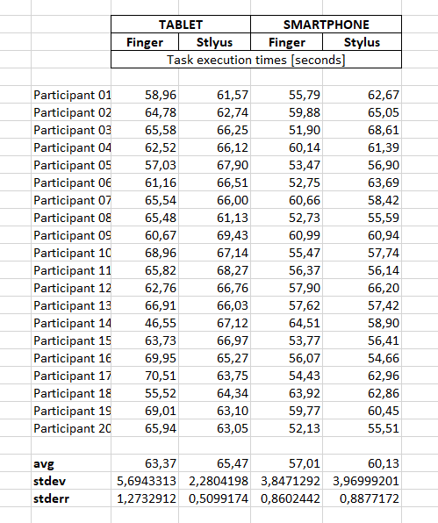
Materials
Week 2

Slide 12
Constructive Alignment: ATs
General info | What the teachers do | What the students do
AT 1 Project activity / Project report | Defining project assignments at the beginning of the semester. Provide support (online & F2F consultations) during the semester. Organizing student presentations, evaluating projects and providing feedback. | Work on the project assignment includes three major groups of activities: (1) implementation of the interactive system and/or interaction methods, (2) organizing and conducting the HCI experiment, (3) statistical analysis of data obtained within the experiment, with drawing conclusions. Teacher support is available during the semester.
AT 2 Mock-up case as an assessment task | Present (prepare and deliver via LMS) a small-scale case study: a hypothetical HCI experiment (description) and corresponding data (online data generators can be utilized). Provide web links to online tutorials and supplementary learning material. Recommend possible software tools. Provide a rubric (a matrix combination of checklist and scoring guide). Support students online (via LMS forum). | Analyze the description and data from the obtained mock-up case. Select the appropriate statistical test for a given case study. Utilize the online resources (tutorials, wide web search), and get familiar with the software selected for statistical analysis. Apply statistical analysis (within software tool), derive conclusions, write and submit report via LMS. If necessary, ask for help / clarifications on the LMS forum. Present the results of the mock-up case analysis.
AT 3 Written exam | Design, preparation and organization of the written exam. Grading exams, providing feedback and exam reviews. | Attending the exam, answering the questions.

Slide 13
Constructive Alignment: AT examples (1/3)
General info | Example | Grading criteria
AT 1 Project activity / Project report | Develop at least two different text entry methods for touchscreen smartphones that are specifically designed for the context of one-handed use. Organize and conduct a controlled HCI experiment that tests both the efficiency and the subjective satisfaction of users when working with the proposed text entry methods. Perform a statistical analysis of the data obtained through the experiment and draw appropriate conclusions and generalizations. Write a project report and prepare a presentation. | 1/3 of the available points – Implementation 1/3 of the available points – HCI experiment 1/3 of the available points – Statistical analysis

Slide 14
Constructive Alignment: AT examples (2/3)
General info | Example | Grading criteria
AT 2 Mock-up case as an assessment task | The experiment investigates the efficiency of text entry based on the WPM metric using a specially developed virtual keyboard for mobile devices. The special feature of this keyboard is that it does not have a standard QWERTY layout, but is based on two alternatives: the user can use an alphabetical order of the keys or a specific order determined as part of predictive modeling using a genetic algorithm. In the controlled experiment, 30 participants took part in the typing tasks in both versions of the keyboard (with alphabetical and specific layout) and in three different ways: one-handed typing with the thumb, typing with two thumbs and typing in cradle mode. The order of the test conditions was properly counterbalanced. Each user entered 30 different phrases for each test condition so that the average performance for each condition could be determined. The mean values of the WPM metric for each participant are available in an Excel file. Perform a statistical analysis of the available data and draw appropriate conclusions. | Contextualization – max 0.5 points Main features of the experiment – max 1.0 point Descriptive statistics – max 1.0 point Tool for statistical analysis – max 0.5 points Inferential statistics – max 1.0 point Statistical test report – max 0.5 points Generalization – max 0.5 points (max 5 points, see Rubric document for details)

Slide 15
Constructive Alignment: AT examples (3/3)
General info | Example | Grading criteria
AT 3 Written exam | You want to experimentally find out in which context online shopping via the appropriate website is faster, less error-prone and more pleasant to use. You are interested in mouse, finger and stylus interaction, where each of the above pointing devices can be used to control a browser on a desktop computer with a touch-sensitive screen, a browser on a smartphone and a browser on a tablet. What are the independent and dependent variables in your experimental design? How many independent and how many dependent variables are there? If the experiment in question were organized and conducted using a repeated measures design, what statistical test (or tests) would you use to process the quantitative data? | Assessment by grade. The answer to the question can be awarded a full score (for a complete answer), a partial score (for an incomplete answer) or zero points (for a completely incorrect or non-existent answer).

Slide 16
EdUnit generalities
Number of credits (estimation 1ECTS =28 hours of work): 0.5
Estimated working time for teachers: 8 hours
Estimated learning time for students (must be consistent with credits): 14 hours
Schedule and activity flow: based on TLAs and ATs

